Slide 1


Release information

Slide 2




ABOUT AMSTELFILM
young film distribution company
passion for art house
future of digital cinema, Amstelfilm releases its films mostly in a digital format (e-cinema) and is currently investigating the digital future of cinema going.
how to create a larger audience for small, beautiful films?

Slide 3
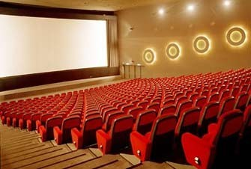
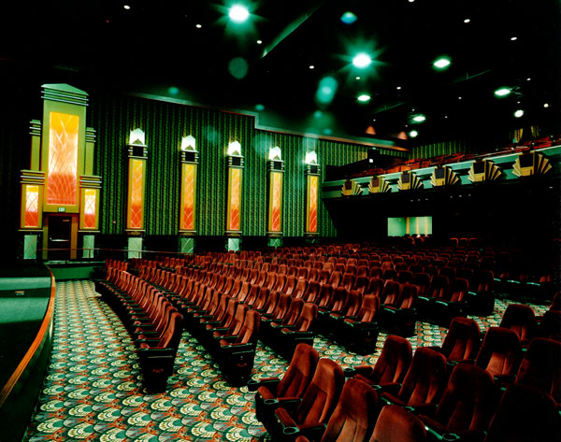
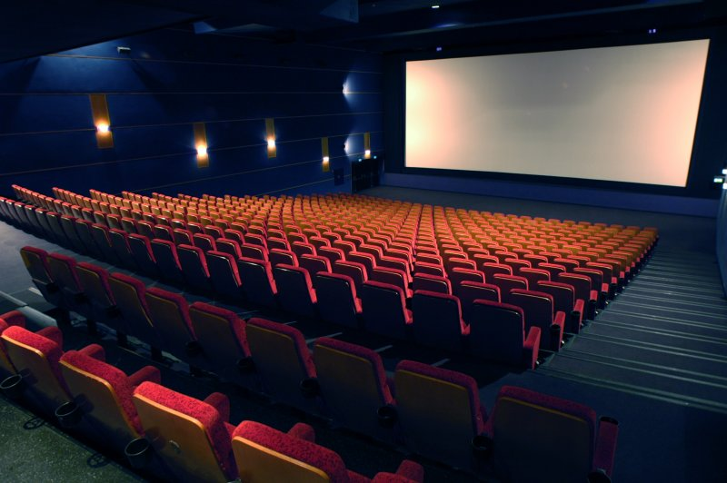
Cinema in The Netherlands
239 Movie theatres
755 Screens
126.355 Seats
Statistics in 2009:
Number of visitors: 27.338.000 (16% growth)
Box office: € 200.975.000,- (21,8% growth)
Average admission per person: € 7,36 (4,8% growth)

Slide 4
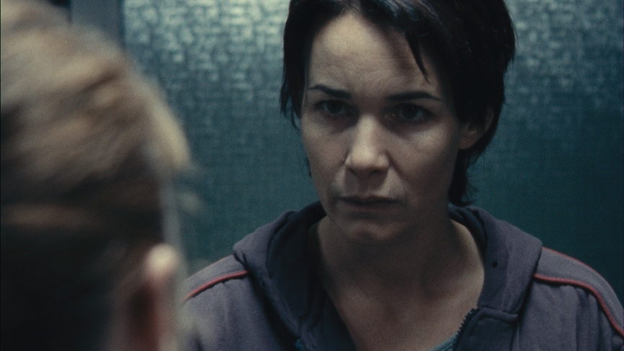
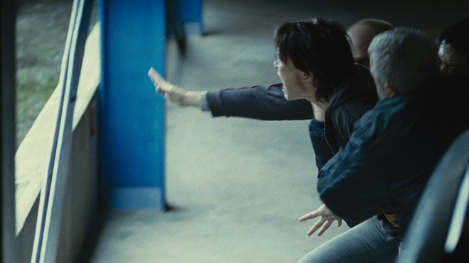
ILLÉGAL
Impressive, heart rending and current drama of a Russian mother who fights her eviction
Info
Director: Olivier Masset-Depasse
Country: Belgium, France, Luxemburg
Language: French, English, Russian
Length : 90 min
Genre : Drama
Important
Belgian candidate for Best Foreign Language Film for the 83rd Academy Awards
Played at Cannes Festival
Current themes: integration and humanity

Slide 5
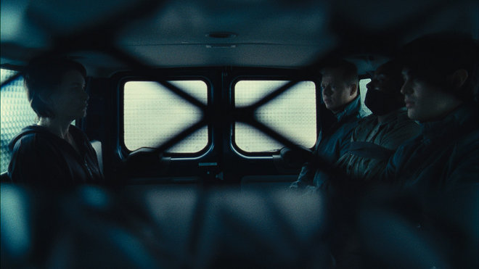
RELEASE ILLÉGAL
Release date: 31 March 2011
7-8 copy’s: 3 of 35mm and 4-5 digital prints
Enthusiastic programmers
Too much competition in February
2 festivals (IFFR &MTM)
Small budget

Slide 6
MARKETING
Mostly a free publicity driven campaign with a focus on the issue of immigration en humanity (which are very actual at the moment, due to political changes all over Europe)
Primary Target Audience:
25+, mostly female, higher educated
Regular visitors of arthouse cinemas
Secondary Target Audience:
People interested in politics and news
People in some way connected to issues of immigration and/or illegal refugees
University students of cultural anthropology and politics

Slide 7
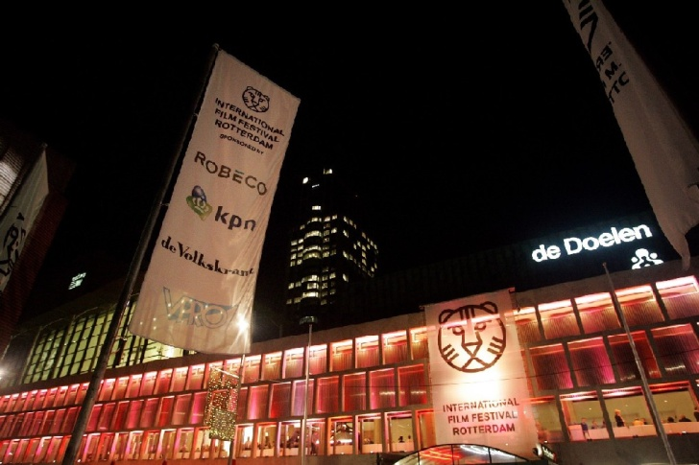

FESTIVALS
International Film Festival Rotterdam (IFFR)
One of the larger festivals in Europe
Offers a quality selection of worldwide independent, innovative and experimental cinema
21 January - 6 February
Results in promotion through their communication channels
Press junket with director, resulting in extra media attention (articles/interviews)

Slide 8


FESTIVALS
Movies That Matter
The international film and debate festival of Amnesty International
Illégal fits in perfectly with the integration and humanity themes
Festival: 24-30 March, The Hague
promotion through their communication channels
Press junket with director, resulting in extra media attention (articles/interviews)
&
Tour in March along 12 theaters
Notes:
<numéro>

Slide 9
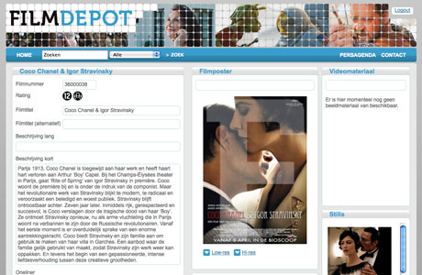
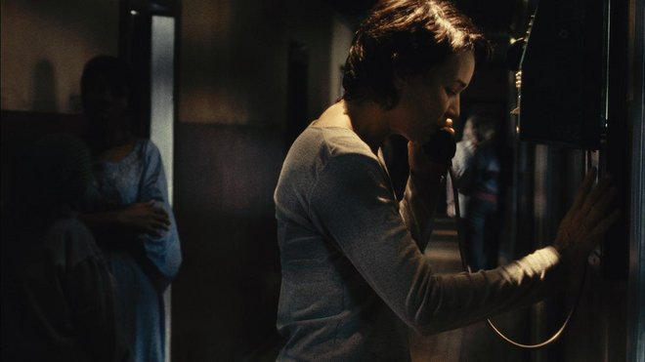
And…
Avant premieres (political org.)
Press screenings & filmmarket
Offline Advertising
post cards/ flyers and posters
Filmdepot.nl: website for digital PR material
Media maps
Online sweepstakes with free tickets
Twitter/youtube/facebook

Slide 10
To explore
Working with other EU distributors ☺
How accurate is illegal in The Netherlands?
Get in touch with political organizations
…

Slide 11
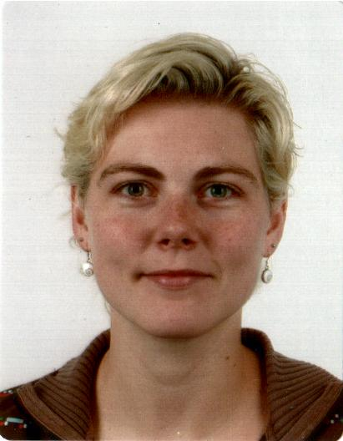
CONTACT
For questions or info: marieke@amstelfilm.nl
www.amstelfilm.nl/illegal
Notes:
<numéro>

